Slide 1
Вредноста на вакцините
Имунизација – потреба и придобивки
Проф. д-р Аспазија Софијанова

Slide 2

Дали може да се замисли животот без чиста вода за пиење?
Само чистата вода за пиење може да биде достоен конкурент на вакцините во намалување на инфективните болести и смртните случаи; дури ни антибиотиците не го имаат тоа влијание⁽¹⁾
Дали може да се замисли животот без вакцини?
(1) Plotkin SL and Plotkin SA. Chapter one. In: Plotkin and Orenstein. Vaccines 1999.
Notes:
2
Reference:
Plotkin SL and Plotkin SA. A short history of vaccination. Chapter one. In: Plotkin and Orenstein. Vaccines, 3rd edition. Philadelphia (PA): WB Saunders, 1999, page 1

Slide 3
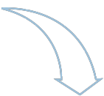

Благодарение на вакцините, ние и нашите деца, денес, не страдаме од многу инфективни заболувања
Вакцините ги ерадицираа големите сипаници (1980), кои претходно убиваа 5 милиони луѓе, секоја година⁽¹⁾
Вакцините го елиминираа полиото од Европа (2002) и спасија 10 милиони луѓе од парализа, ширум светот⁽¹⁾
Polio
Diphtheria
Haemophilus
Influenzae type b
Measles
1008
54,645
2,391
624,847
-100%
-98,7%
-90,4%
-95,4%
0
688
229
28,789
Peak 2004
Peak 2004
Peak 2004
Peak 2004
Намалување на случаите на болести, кои можат да се превенираат со вакцини, во Европа⁽¹⁾
(1) WHO
Notes:
Comments- details:
Вакцините ги ерадицираа големите сипаници (1980), кои претходно убиваа 5 милиони луѓе, секоја година².
Во раните педесетти – 150 години по воведувањето на вакцинацијата – се претпоставува дека, во светот, се појавувале 50 милиони случаи на голема сипаница, секоја година. Оваа бројка се намалила на околу 10-15 милиони до 1967, како резултат на вакцинацијата. Во 1967 година, кога СЗО го стартувала интензивниот план за ерадикација на големите сипаници, “древното зло” се заканувало на 60% од светската популација, го убивала секој четврти заразен, ги сакатела или ослепувала повеќето од преживеаните, а соодветна терапија не постоела. Стапката на смртност од variola vera била околу 30%².
Вакцините го елиминираа полиото од Европа (2002) и спасија 10 милиони луѓе од парализа, ширум светот³.
Глобалната иницијатива за ерадикација на полиото започнала во 1988. Повеќе од 10 милиони луѓе, кои би биле парализирани, денес одат, благодарение на тоа што биле имунизирани против полио. Бројот на случаите на полио се намалиле за повеќе од 99%, од околу 350 000 случаи во 1988 г., на 223 случаи во 2012 г. Во 2008, само 4 земји во светот остануваат да бидат полио-ендемични (Авганистан, Индија, Нигерија и Пакистан). Една од 200 инфекции води до иреверзибилна парализа (најчесто на нозете). 5% до 10% од парализираните умираат, кога нивните мускули вклучени во дишењето, се имобилизираат.
Тетанус, дифтерија, рубела, менингитис и рак на црн дроб (како последица од хепатитис Б), се драматично редуцирани.
Инциденцата на Haemophillus Influenza type B, во Европа, е редуцирана за преку 90%.
Морбилите се ставени под контрола во САД и делови од Европа, а драматично се намалени во Африка, каде бројот на смртни случаи е опаднат за 91%.
Polio
The Global Polio Eradication Initiative was launched in 1988. More than five million people who would otherwise have been paralysed are today walking because they have been immunized against polio since the initiative began. Polio cases have decreased by over 99% since 1988, from an estimated 350 000 cases then, to 1997 reported cases in 2006. The reduction is the result of the global effort to eradicate the disease. In 2008, only four countries in the world remain polio-endemic, down from more than 125 in 1988. The remaining countries are Afghanistan, India, Nigeria and Pakistan. One in 200 infections leads to irreversible paralysis (usually in the legs). Among those paralysed, 5% to 10% die when their breathing muscles become immobilized. (1)
Smallpox
In the early 1950s – 150 years after the introduction of vaccination – an estimated 50 million cases of smallpox occurred in the world each year, a figure which fell to around 10–15 million by 1967 because of vaccination.
In 1967, when WHO launched an intensified plan to eradicate smallpox, the "ancient scourge" threatened 60% of the world's population, killed every fourth victim, scarred or blinded most survivors, and eluded any form of treatment. The fatality rate of variola major was around 30%. (2)
References:
(1) WHO website: WHO http://www.who.int/mediacentre/factsheets/fs114/en/index.html
(2) WHO website: http://www.who.int/mediacentre/factsheets/smallpox/en/
(3) WHO website http://www.who.int/immunization_monitoring/data/GlobalImmunizationData.pdf
Reference of graphs:
WHO, September 2005: Cases of vaccine-preventable diseases in the WHO European region

Slide 4
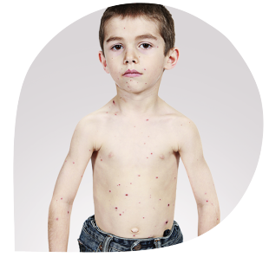
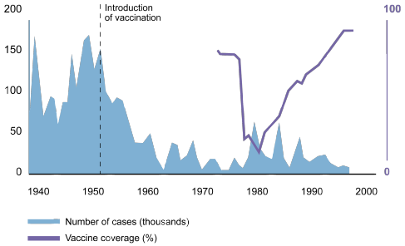
Ние можеме да заборавиме на болестите, но тие никогаш нема да не заборават нас
Number
of cases
x 100.000
Vaccination coverage (%)
90% Coverage
Outbreaks subside
80% Coverage
2 000 cases
Морбилите, сеуште убиваат во Европа
2006-2007, 7 смртни случаи и над 5000 хоспитализации, во повеќе од 10 земји⁽²⁾
2006, 614 пријавени случаи во Германија, 95 деца се хоспитализирани и 2 смртни случаи ⁽³⁾
2008: >1,300 потврдени случаи во Англија и Велс⁽⁴⁾
повеќе од 80% не биле вакцинирани^{(2,3)}
Целта на WHO во Европа да се елиминираат морбилите и рубелата, до 2010, не е сеуште остварена⁽⁵⁾
20% Coverage
45 000 cases
Враќање на пертусисот во Обединетото Кралство (епидемија 1977-79), како резултат на недоволната покриеност со вакцинацијата⁽¹⁾
(1) Immunisation against infectious disease 1996, Eds. Salisbury DM and Begg NT. In: Edward Jenner, Bicentenary Edition
(2) M. Muscat et al., The Lancet; 7 Jan 09
(3) Whichmann O et al., Bull WHO 2009;87:108-115
(4) Health Protection Agency 2009
(5) WHO Europe, September 2005
Notes:
4
Comments: Adapt and add local data (other diseases) according to your local context
WHO Euro call to action 2008:
« In the European Region, 32 000 children still die each year from vaccine-preventable diseases and some 600 000 infants miss their basic vaccine doses of diphtheria, tetanus and pertussis (DTP)…” said Dr Danzon, head of WHO Euro. WHO Regional Office for Europe. Immunization and the paradox of success. Copenhagen April 21, 2008; http://www.euro.who.int/mediacentre/PR/2008/20080421_1 [accessed March 13, 2009].
« To our shame, European children still die from vaccine-preventable killers or related causes. Medical science has provided vaccines against over 20 serious diseases and evidence of the success is as robust as it is edifying. Governments should convey this message unequivocally and relentlessly to their people. Not to vaccinate a child is to allow killer diseases to continue to circulate in the family, in the community and in the world beyond.
European Immunization Week, celebrated in April, is an annual occasion to assist governments in the WHO European Region to do just that. It provides a regional focus and framework for politicians and health professionals to galvanise support for immunization programmes and to analyse where the gaps in coverage lie that allow for the kind of measles outbreaks we are currently witnessing in various western European countries. » WHO Euro – 24 July 2008 : Jagessar N, et alii, Editorial: Immunization – Mind the Gap, Vaccine 26 (2008) 6736–6737
Return of Pertussis in the UK (from EVM paper Paediatric Council recommendations Europe 23 Feb 09)
During the 1977-79 epidemic: 4% of patients reported in 21 health areas were hospitalized (40% were less than 6 months of age). Among those hospitalized, 1% required intensive care; one-third of these had complications. 12% of patients with complications had pneumonia, and 5% had convulsions. Applying these figures to the entire population of England and Wales indicates that, during the epidemic, as many as 5,000 children were admitted to hospitals (2,000 were less than 6 months of age); 50 required intensive care; 200 developed pneumonia; and 83 had convulsions. In both Glasgow and Edinburgh, extra wards were opened to accommodate children with pertussis. [4] The decline in immunization uptake was a direct consequence of publicity in the press, on radio and television given the alleged hazards of immunization and it is likely to take several years before this damage of the immunization programme can be overcome. [5] The recovery in the uptake of whole cell pertussis vaccine from 30% in 1978 to 91% in 1992 has resulted in a major reduction in the incidence of pertussis, (...). As illustrated in this has been accompanied by a decline in pertussis mortality rates. [6]
Measles:
WHO calls for scaling up of measles vaccination. Children in affluent European countries have a higher risk of infection, 26 February 2009
The WHO Regional Office for Europe calls on governments, health professionals, civil society and donors rapidly to scale up national immunization programmes, as outbreaks of measles grow larger and cross country borders. This highly contagious respiratory illness could spread because many children are not immunized or have received less than the required two doses of measles vaccine.
The decline in immunization rates is attributable to a combination of vaccine scepticism born of ideological positions and, ironically, the success of immunization programmes in earlier generations. In addition, some hard-to-reach vulnerable groups in every country still lack access to immunization. Further, the challenges to immunization are fed by disturbing and dangerously misleading anti-vaccination advocacy campaigns.
Paradoxically, although measles can be avoided through simple and inexpensive vaccines, children in affluent countries have a greater risk of infection. Over the last 12 months, over 8145 measles cases have been reported in the Region. Six western countries – Austria, Germany, Italy, Spain, Switzerland and the United Kingdom – and Israel accounted for 86% of them.
In Switzerland, a measles outbreak began in November 2006 with 73 reported cases, and peaked in March 2008, with 2195 reported cases for that year; 500 of them involved complications. This outbreak is continuing. In up to 98% of all cases, the sick children were unvaccinated or only partly vaccinated, mainly by the decision of their parents.
References:
M . Muscat et al., Measles in Europe: an epidemiological assessment; The Lancet; 7 January 2009
Whichmann O et al. "Further efforts needed to achieve measles elimination in Germany: results of an outbreak investigation" Bull WHO 2009;87:108-115
Health Protection Agency 2009 - http://www.hpa.org.uk/webw/HPAweb&HPAwebStandard/HPAweb_C/1233822584984?p=1231252394302
Pertussis: England and Wales; Morb Motal Wkly Rep; 1982; 31(47): 629-632
Whooping cough surveillance; Wkly Epidemiol Rec; 1983; 58(4): 23-25
Miller E et al. ; The epidemiology of pertussis in England and Wales; Commun Dis Rep; 1992; 2(13): R152-R15
Graph references: Salisbury D. The immunization program in England: 25th National Immunization Conference Proceedings 1991, Centers for Disease Control and Prevention, Atlanta, GA, 1992: 49–52.
See also more recent reference: Gangarosa EJ et al; Lancet 1998; 351(9099):356-61

Slide 5
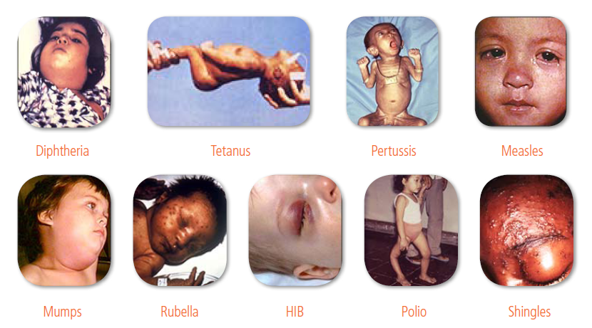
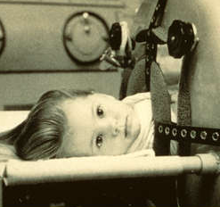
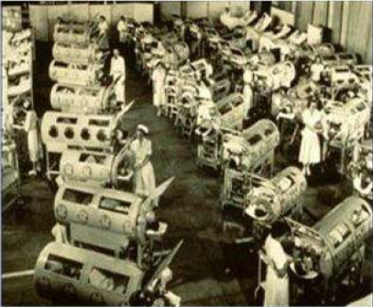
The burden of vaccine preventable diseases
Pneumococcus can lead to life threatening diseases including meningitis and pneumonia³, which alone cause the death of more than 2 million children each year⁴
Polio invades the nervous system and can cause crippling paralysis ⁵
Rotavirus gastroenteritis is estimated to cause more than half a million child deaths each year⁶
Influenza can cause severe illness, hospitalisation and death – up to 500,000 according to WHO estimates⁷
Notes:
For example:
Pneumococcal disease – an infection caused by a bacteria known as ‘pneumococcus’ – can cause a range of life-threatening diseases including meningitis, bacteraemia (a form of blood poisoning) and pneumonia – which is itself causes more than 2 million child deaths a year
Polio is a highly infectious disease which invades the nervous system and can cause crippling paralysis in a number of hours. In the pre-vaccine era virtually all children were infected with polio viruses, with annual epidemics leaving thousands of victims using crutches, braces, wheelchairs and iron lungs
Rotavirus is the leading cause of acute gastroentiritis (diarrhoea and vomiting). It leads to hospitalisation of children around the world, resulting in an estimated half a million deaths a year – which equates to one child per minute.
Seasonal influenza is an acute viral infection that causes respiratory illnesses – especially dangerous for high risk populations such as children, the elderly and people with underlying chronic medical conditions, in whom it can cause hospitalisation and death

Slide 6
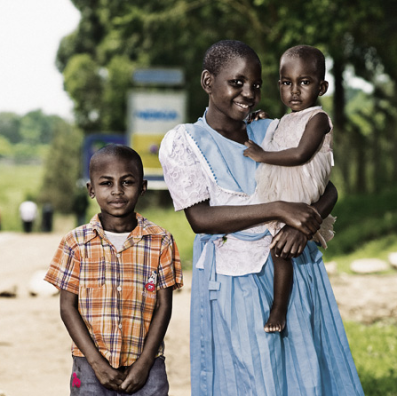
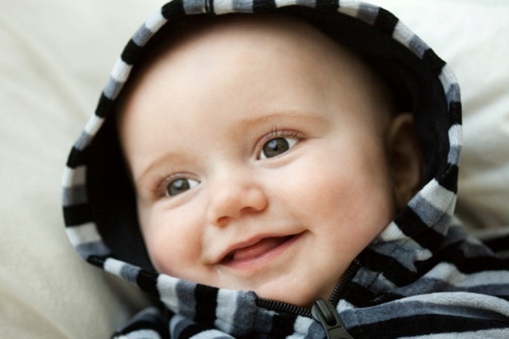
What vaccination can achieve
Globally:
  Approximately 700,000 deaths caused by pneumococcal disease could be prevented by 2015⁸
  Cases of polio are down by over 99% - from over 300,000 per year in 1988 to less than 2,000 in 2009⁹
  Some countries have witnessed declines in hospitalisations due to rotavirus infection of up to 80%¹⁰
  Illnesses and complications caused by influenza can be reduced by 60%, and deaths by 80%, in elderly patients¹¹
GlaxoSmithKline has vaccines in all these disease areas
Notes:
But vaccination campaigns have been hugely impactful:
Since the introduction of pneumococcal conjugate vaccines (PCVs) in the US, hospitalisations due to pneumonia have been reduced by over a third – and it is estimated that globally 700,000 deaths caused by pneumococcal disease could be prevented in the next four years (by 2015)
Following the World Health Assembly’s resolution to eradicate polio in 1988, cases have been reduced by 99%
In countries where rotavirus vaccines have been introduced, hospitalisations due to rotavirus infection have been reduced by up to 80%
And where successful influenza vaccination campaigns have been rolled out, illnesses can be reduced by up to 90% in healthy adults, and by 60% in the elderly – resulting in a reduction in mortality of 80%

Slide 7
The impact of vaccination
Disease effect | Vaccine impact
Pneumococcal disease can lead to life-threatening diseases such as pneumonia – which alone causes 2 million deaths among children a year⁴ | Approximately 700,000 deaths caused by pneumococcal disease could be prevented by 2015⁸
Rotavirus gastroenteritis is estimated to cause more than half a million child deaths each year⁶ | Some industrialised countries have witnessed declines in hospitalisations due to rotavirus infection of up to 80%¹⁰
Influenza can cause up to 500,000 deaths a year according to WHO estimates⁷ | Deaths can be reduced by 80% in elderly patients⁷
Pre-vaccines virtually all children were infected with polio viruses and on average one in 200 infections leads to irreversible paralysis⁵ | Cases of polio are down by over 99% - from over 300,000 per year in 1988 to less than 2,000 in 2009⁹
⁴ Rudan I et al 2008
⁸ GAVI Alliance, 2011
⁵ WHO, November 2010
⁹ WHO, December 2010
⁶ WHO. April 2011
¹⁰ Patel et al, 2011
⁷ WHO, April 2009
Notes:
For example:
Pneumococcal disease – an infection caused by a bacteria known as ‘pneumococcus’ – can cause a range of life-threatening diseases including meningitis, bacteraemia (a form of blood poisoning) and pneumonia – which is itself causes more than 2 million child deaths a year. Since the introduction of pneumococcal conjugate vaccines (PCVs) in the US, hospitalisations due to pneumonia have been reduced by over a third – and it is estimated that globally 700,000 deaths caused by pneumococcal disease could be prevented in the next four years (by 2015)
Rotavirus – the world’s leading cause of acute gastroentiritis (diarrhoea and vomiting) – leads to hospitalisation of children around the world, resulting in an estimated half a million deaths a year – which equates to one child per minute. In countries where rotavirus vaccines have been introduced, hospitalisations due to rotavirus infection have been reduced by up to 80%
Seasonal influenza is an acute viral infection that causes respiratory illnesses – especially dangerous for high risk populations such as children, the elderly and people with underlying chronic medical conditions, in whom it can cause hospitalisation and death. Where successful influenza vaccination campaigns have been rolled out, illnesses can be reduced by up to 90% in healthy adults, and by 60% in the elderly – resulting in a reduction in mortality of 80%.
Polio is a highly infectious disease which invades the nervous system and can cause crippling paralysis in a number of hours. In the pre-vaccine era virtually all children were infected with polio viruses, with annual epidemics leaving thousands of victims using crutches, braces, wheelchairs and iron lungs. Since the World Health Assembly’s resolution to eradicate polio in 1988, cases of the disease have been reduced by 99%

Slide 8
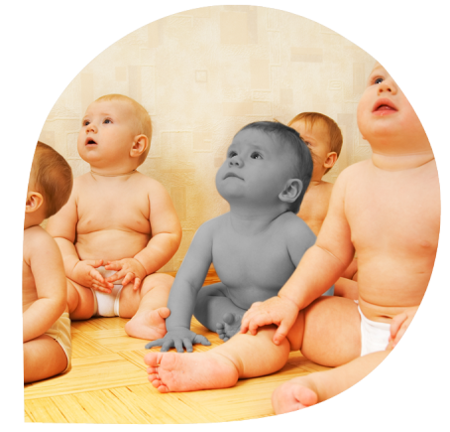
Вакцините ги заштитуваат и не-вакцинираните
Кога доволен број на луѓе се вакцинирани болеста не може повеќе да се шири ^{(1,2)}
Овој ‘имунитет на заедницата’ или ‘herd
immunity’ ги заштитува и најранливите ⁽¹⁾
T Jacob John & Reuben Samuel. Eur J Epid 2000;16:601-6
Gonçalves G, Expert Rev. Vaccines 7(10), 1493-1506 (2008)
Notes:
Comments and additional data:
Vaccinated people protect themselves and prevent infection spreading.
Herd immunity is the resistance of a population to the spread of an infectious organism due to the immunity of a high proportion of individuals within the population.
Immunisation of a large percentage of a population creates herd immunity, as the vaccinated individuals provide a form of indirect protection for susceptible individuals i.e. those who are unvaccinated or have a deficient immune system (eg elderly, people diagnosed with diseases affecting the immune system).
The result is that fewer people become infected and those that do become infected may not pass the infection on to others as those they come in contact with may also have been vaccinated.
By protecting yourself, you also protect your family and your community, especially the most vulnerable (children, elderly, people with deficient immune systems). Thus everyone contributes to and benefits from collective vaccine protection.
Mean thresholds of vaccination coverage to create herd immunity for a specific disease:
Smallpox, Diphteria, Polio, Rubella, Mumps 80-85%
Whooping cough, Measles 90-95%
(Figures from D. Levy-Bruhl, French Institute for Health Surveillance – INVS, Academic lecture on immunology, Paris, 2007)
EVM message (from EVM paper on Paediatric Council recommendations Europe 23 Feb 09):
For most vaccine-preventable diseases, vaccination reduces disease incidence by the direct protection of the immunized individual and also by the indirect protection of the un vaccinated population. This herd protection affects non-immune people whether in homes, schools, the workplace or in the community. This is known as “herd immunity”. As a high vaccination coverage is achieved in a community or nation, the risk to unvaccinated people decreases. The vaccination coverage that needs to be achieved for optimal herd immunity varies, depending on the disease and the immune response to the vaccine. In this way, protection from disease is conferred on the entire population – even those who are unvaccinated.
Many communicable diseases occur naturally in epidemic waves, initiated by a lack of herd immunity in a given population; this phenomenon can also be simulated by means of theoretical modeling. Outbreaks are often reported around borders with countries where communicable diseases are still highly prevalent. Index cases can also be imported from one country where the disease is endemic to another due to international travel especially by residents visiting their home country e.g. North Africa (Morocco, Egypt), Turkey, or other areas where these diseases are still endemic.
In addition, some outbreaks of disease can be directly attributed to decreased vaccination rates. Recent examples include the resurgence of pertussis in Europe after stopping DTPw immunization in the 80's (UK, Italy, several German Landers), the cross-border diphtheria epidemic from Russia to North Eastern Europe in the 90's (in absence of diphtheria vaccine boosters) and the various measles outbreaks across Europe over the last 10 years (UK, Germany, Switzerland, etc.).
A study of the 2006-7 measles epidemics in Europe published in the Lancet (3) found cases that 56% of the cases reported as being 'imported‘ came from another country within Europe and 20% from Asia.
References:
(1) T Jacob John & Reuben Samuel. Eur J Epid 2000;16:601-6
(2) Gonçalves G, Herd immunity: recent uses in vaccine assessment, Expert Rev. Vaccines 7(10), 1493-1506 (2008)
(3) M . Muscat , H . Bang , J . Wohlfahrt , S . Glismann , K . Mølbak; Measles in Europe: an epidemiological assessment; The Lancet; 7 January 2009; Early Online Publication

Slide 9
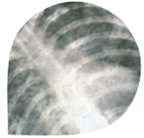
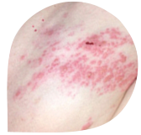
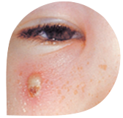
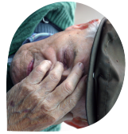
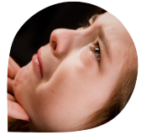
Вакцините заштитуваат не само од болеста
Превенцијата од морбили, може да превенира пневмонија, енцефалитис и смрт;
Превенцијата на дифтерија, може да превенира напади на грчеви, оштетување на мозокот и евентуална смрт;
Превенцијата од пневмококни инфекции, заштитува од пневмонија, септикемија и менингитис, а исто така, може да ја намали анти-микробната резистенција
Превенција од грип може да превенира пневмонија и последователна хоспитализација, па и смрт
US Center for Disease Control and Prevention disease fact sheets http://www.cdc.gov/vaccines/vpd-vac/vpd-list.htm – last accessed March 2009
Kyaw et al. CID, 2003; 37(10)
Notes:
9
Adapt and add local data (other diseases) according to your local context
Potential medical impact of some vaccine preventable diseases
Measles Pneumonia, encephalitis, death
Chickenpox Encephalitis, secondary infections (severe stretococcus, skin infection), hepatitis, pneumonia
Pneumoccocal disease Bacterial meningitis, blood infection, septicemia
Seasonal Flu Ear and sinus infections, pneumonia, heart inflammation and death
Rotavirus gastroenteritis Severe dehydration (loss of 10% of the child weight), sometimes death
Whooping Cough (Pertussis)Coughing spells so bad that it is hard to eat, drink or breathe. Can last for weeks, lead to pneumonia, seizures (jerking and staring spells),
brain damage or death
Hepatitis B Scarring of the liver (cirrhosis), liver cancer
Haemophilius influenza type b (Hib) Bacterial meningitis leading to brain damage or death
Tetanus Painful tightening of muscles, can lead to "locking" of the jaw, and death in 10% of cases
Polio May lead to paralysis and death
Diphteria Can lead to breathing problems, paralysis, heart failure and even death
meningo Blood infection, meningitis, 9-12% of cases die; in 20% of cases who recover: permanent hearing loss, limb loss or brain damage
Mumps Deafness, meningitis (infection of the brain and spinal cord covering), painful swelling of the testicles or ovaries and, rarely, death
Rubella In women: arthritis, risks of miscarriage, congenital anomaly (deaf, blind or mentally retarded or with heart or brain damage)
HPV Precancerous cervical, vulvar and vaginal lesions; cervical, vulvar and vaginal cancer; genital warts
Herpes zoster (shingles) Long-lasting pain that can persist for months
References: US Center for Disease Control and prevention (CDC), disease fact sheets http://www.cdc.gov/vaccines/vpd-vac/vpd-list.htm – last accessed March 2009
Fighting antimicrobial resistance
see EVM paper on anti-microbial resistance, November 2008
http://www.evm-vaccines.org/pdfs/European%20Antibiotic%20Awar...%20PR%20EFPIA%2019%20November%202008.pdf
On resistance of pneumo strains to antibiotics: Fedson and Musher. In: Vaccines, 4th ed., 2004

Slide 10
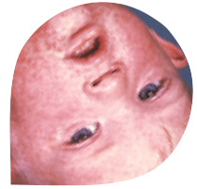

“Вакцинацијата е несомнено еден од најголемите трошковно-ефективни достигнувања на модерното време”
WHO Европа
Споредба на интервенциите поврзани со јавното здравје
Mandatory
Seat-belt-use law
69 $
Courtesy of CDC
Influenza vaccination
for all citizens
140 $
Трошок за спасена една година живот
Лекување на морбили
чини €209-480 по случај*;
а вакцинацијата
€0.17-0.97 по лице
Pneumonia vaccination
for seniors
2 200 $
Chlorination
of drinking water
3 100 $
Smoking-cessation
advice for smokers
9 800 $
Child restraint
systems in cars
73 000 $
Source : Tengs TO, Adams ME, Pliskin JS, Safran DG, Diegel JE, Weinstein MC, Graham JD, Five hundred life-saving interventions and their cost-effectiveness. Risk Anal. 1995 Jun ; 15(3) 369-390
* in 11 Western European countries
Notes:
Caution when using these data:
These figures are quite old and deemed subject to controversy.
Additional data and comments:
« Immunization remained one of the most successful and cost-effective health systems interventions in medical history », M. Danzon head of WHO Euro - WHO Regional Office for Europe. Immunization and the paradox of success. Copenhagen April 21, 2008
« Among all public health provisions national immunization programs are beyond doubt one of the most effective in reducing mortality, morbidity, and costs associated with major infectious diseases. »
T.G. Kimman, H.J. Boot, G.A. Berbers, P.E. Vermeer-de Bondt, G. Ardine de Wit and H.E. de Melker, Developing a vaccination evaluation model to support evidence-based decision making on national immunization programs, Vaccine 24 (May (22)) (2006), pp. 4769–4778.

Slide 11

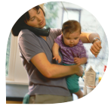
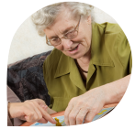
Вакцинацијата е повеќе од здравствена заштита и за поединците и за заедницата
Вакцинацијата против HPV може да го намали стресот и стравот од потенцијална прогресија на цервикалната лезија во цервикален канцер и страдањата од последователни терапии и хируршки зафат
Вакцинацијата против Rotavirus кај новородените го намалува фамилијарното нарушување и анксиозноста на родителите ^{(1,2)}
Намалување на болестите кои можат да се превенираат со вакцини, се подобрува функционирањето на болниците, центрите за згрижување, образованието и бизнисот ^{(4,5,6)}
Грипот опфаќа 10-12%
од сите боледувања и отсуство од работа, во Европа ⁽⁷⁾
(1) Van Damme P et al. Lancet Infect Dis 2006;6:805-812 ;
(2) IP N. Parez, La Lettre de l’Infectiologue, XXI,6, Nov-Dec 2006 ;
(3) Schmader KE et alii, Clin J Pain 2007; 23:490-96 ;
(4) Giaquinto C et al.. J Infect Dis 2007;195:S36-S44;
(5) H. Haas et al., Médecine et maladies infectieuses 38 (2008) 642–647
(6) Fau C et al.; Archives de Pédiatrie 2008;xxx:1-10;
(7) Ryan J, Zoellner Y et al., Vaccine 2006; 24 (47-48): 6812-22;
(8) De Spiegelaere M et al., Rev d'épidémiologie et de santé ublique1996, vol. 44, no3, pp. 228-236
Notes:
Comments on left-hand column (see below for comments on right-hand column):
Psychological distress caused by adnormal pap-smears and cervical lesions
While anxiousness often precedes screening results, awaiting new test results for 3 months to confirm or infirm an abnormal result is a source of acute anxiety for women. Women with high-grade lesions will have to undergo surgical treatment to remove the lesions with potential negative impact on fertility [1] Cervical cancer treatment requires major interventions (surgery, radiotherapy, chemotherapy) [1] and is associated with considerable physiological and psychological consequences, including sex impairment [2].
Rotavirus gastroenteritis in infants below 5 years causes considerable stress for parents, family disruption, childcare problems and lost days from work. A recent study of the burden of rotavirus diarrhoea among children attending day-care centres in Lyon, France, found that in 58% of cases at least one parent was required to take leave of absence from work [7]. When the disease is severe and requires hospitalisation, parents endure increased anxiety, one of them spends one night at the hospital and takes a longer leave from work (3 days in average). Additional childcare arrangements are also required for up to a quarter of cases [4]. The mean number of working days lost by parents or other persons caring for children with rotavirus gastroenteritis ranged from 2.3 days (hospital, France) to 7.5 days (primary care, UK) [8].
Shingles severely impacts all daily activities - work, walk, sleep, shopping – as well as social life and leisure [5]. Shingles can persist for months, limit basic activities (dressing, bathing, mobility) and cause depression and social isolation [6].
Vaccination is a major contributor to UN Millenium Development Goals
See http://www.un.org/millenniumgoals/childhealth.shtml
References:
[1] Agence Nationale d’Accréditation et d’Évaluation en Santé. Clinical practice guidelines: Management of a patient with an abnormal cervical smear. 2002
[2] NCI website www.cancer.gov/cancertopics/pdq/treatment/cervical/HealthProfessional/ – last accessed on 24 March 2009.
[3] Van Damme P et al. Rotavirus vaccines: considerations for successful implementation in Europe. Lancet Infect Dis 2006;6:805-812
[4] IP N. Parez [Rotavirus gastroenteritis: impact of the disease on the parents of hospitalized children: results of a national study] La Lettre de l’Infectiologue - Tome XXI - n° 6 – Nov-Dec 2006
[5] Schmader KE et alii, The Impact of Herpes Zoster Pain and Discomfort on Fonctional Status and Quality of Life in Older Adults, Clin J Pain 2007; 23:490-96.
[6] Schmader KE, Epidemiology and Impact of Quality of Life of Postherpetic Neuralgia and Painful Diabetic Neuropathy, Clin J Pain 2002;18:350-54.
[7] Fau C et al. Epidemiology and burden of rotavirus diarrhea in day care centers in Lyon, France; Archives de Pediatrie 2008;xxx:1-10
[8] Giaquinto C et al. Costs of community-acquired pediatric rotavirus gastroenteritis in 7 European countries: The REVEAL Study. J Infect Dis 2007;195:S36-S44.
Comments and additional data on right-hand column:
Burden of Rotavirus gastroenteritis on health system and society:
Rotavirus gastroenteritis in infants is a heavy burden on health systems. The disease is time-consuming for healthcare workers, causes management problems in hospitals (1-3). It is also major cause of nosocomial infections which requires extra beds and costs (4-5).
In France, it results annually in 33,000 hospitalisations, 55,000 office visits and 11,000 nosocomial infections leading to extra work and costs. Overall in France the disease costs 63 M€ to healthcare-payer and 117 M€ to society when all direct and indirect costs are included (1).
Absenteism:
The number of sick leave days and the related cost were approximately twice less important for vaccinated employees, economically justifying this vaccination including a period of weak epidemic, as checked over three consecutive years in France (6-7).
Equity:
Belgium: School vaccination programmes appears as an effective strategy to reduce social inequalities regarding vaccine preventable diseases. (8)
UK: « Specific interventions exist to reduce the risk of disease in the UK: immunisation, hygiene and travel medicine Initiatives… All have the potential to reduce health inequalities. There is evidence that many of these interventions are effective and some could achieve rapid improvements. However, it has been shown that immunisation uptake is lower in deprived areas » (9)
WHO Director-General Dr. Margaret Chan noted, "The objective of Vaccination Week is to promote equity and access to vaccination," and commended the American and European initiatives, saying they are "helpful to the countries in building their own vaccination programs and reaching out to people in need." (10)
References:
(1) Huet F et al. Burden of paediatric rotavirus gastroenteritis and potential benefits of a universal rotavirus vaccination programme with RotaTeq® in France. Vaccine 2007;25:6348-6358.
(2) H. Haas et al. Assessment of workload in pediatric emergency units due to acute gastroenteritis during the epidemic season in France, Médecine et maladies infectieuses 38 (2008) 642–647
(3) Statement from the German Academy for Children and young people's medicine [Deutsche Akademie für Kinder- und Jugendmedizin e.V. ] - Committee for infectious diseases and vaccination queries), Rotavirus vaccination recommendation, 06/06/06.
(4) Gleizes O et al. Nosocomial rotavirus infection in European countries - A review of the epidemiology, severity and economic burden of hospital-acquired rotavirus disease. Pediatr Infect Dis J 2006;25:S12-S21.
(5) Cunliffe NA et al. Healthcare-associated rotavirus gastroenteritis in a large paediatric hospital in the UK. J Hosp Infect 2007;67:240-244.
(6) F. Dutheil et al., Médecine et maladies infectieuses 38 (2008) 567–573
(7) Ryan J, Zoellner Y et al. Establishing the health and economic impact of influenza vaccination within the European Union 25 countries, Vaccine 2006; 24 (47-48): 6812-22
(8) De Spiegelaere M et al., Inégalités sociales et prévention : le statut vaccinal des adolescents = Social inequalities and prevention : vaccinal status of the adolescents Revue d'épidémiologie et de santé publique 1996, vol. 44, no3, pp. 228-236
http://cat.inist.fr/?aModele=afficheN&cpsidt=3117232
(9) Health Protection Agency, Health Protection in the 21th Century – Understanding the burden of disease, Preparing the future, 2005
(10) http://www.paho.org/English/DD/PIN/pr080416.htm

Slide 12
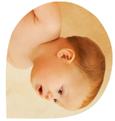




Vaccines protect us throughout our lives
Infectious diseases kill more adults than children ⁽¹⁾
Childhood vaccines protect children against 15* diseases
HPV vaccination of girls and young women helps protect against cervical cancer later in life
Meningococcal vaccination can protect adults and travellers from meningitis and septicaemia
Foreign travel can expose us to a variety of diseases at any time of life (eg hepatitis A, typhoid)
Pneumococcal vaccination protects young and elderly from pneumonia, septicaemia & meningitis
Influenza vaccination can protect people of all ages from influenza, secondary bacterial pneumonia and aggravation of chronic diseases
Vaccination is an integral part of healthy aging
(1) Poland GA, et al. Vaccine (2009)
* Diphtheria, Tetanus, Poliomyelitis, Whooping cough, Haemophilius influenza type B infections, Hepatitis B, Meningococcal infection, Tuberculosis, Rotavirus gastroenteritis, Measles, Mumps, Rubella, Influenza, Pneumoccocus infections, Chickenpox.
Notes:
Note: Adapt and add local data (other diseases) according to your local context
Comments and additional data:
Vaccine-preventable disease (VPD) mortality in adults vs children in the US: « At the current time, approximately 200 children die of VPDs each year, while 70,000 adults die due to VPD - a stunning 350-fold difference. With further movement of the population structure to older ages,the absolute and relative number of adults ill or dying of VPDs will continue to increase. Thus, improving the immunogenicity and efficacy of vaccines in the elderly, as well as the further development of directed adjuvants to aid immunogenicity, is key to addressing this issue. » (1)
WHO recommends universal influenza vaccination for the elderly with 75% target coverage by 2010
Every year in France flu viruses cause respiratory infections in around 2,5 million people. Before vaccination was introduced, between 4,000 and 33,000 people died of flu every year (2). Today in France, 1,500 to 2000 people die every year of flu. 75% are more than 65 of age.
In France every year, there around 123,000 cases of pneumoccocal pneumonia (Léophonte, 2002). Annually, between 5,900 and 15,800 people die of community acquired pneumonia. More than 90% are above 60 years of age. (3).
10 to 15% of people hospitalised for pneumonia die, mortality is 12% higher in people over 65 in the first month after admission (4) Mortality rate ranges from 40 to 57% in nursing home and residential institutions (5)
Healthy ageing:
“Ageing is not only a major risk factor for infection, but infection may also contribute to the ageing process. […] Infections may participate in ageing throughout life and certainly participate towards the end of life. Infectious disease specialists will be increasingly confronted in the next few decades with the problems and issues of a fast-growing elderly population » (6)
Foreign travel can expose us to a variety of diseases (hepatitis A, typhoid fever, cholera, rabies…).
Hepatitis B : In Europe HBV accounts for 22,000 deaths every year with up to 25% of chronic carriers dying from cirrhosis or HBV-related liver cancer. (7)
Mumps: 50% rise in students in England and Wales
The number of mumps cases notified in England and Wales has increased in the first part of 2009 in association with outbreaks in several universities and colleges. In January there were 265 cases of mumps, compared to 177 in the same month last year and 150 in January 2007. The cases are mostly among older teenagers and adults in their twenties as they were too old to have been vaccinated with the measles, mumps and rubella jab when it was introduced in 1998. An epidemic of mumps struck the same group in 2005 when there were 43,000 cases. Since then cases of mumps have declined but remained higher than normal. The rise is not due to low uptake rates of the MMR jab because the cases have not been seen in the younger age groups who should receive the vaccine. (Health Protection Agency 13 March 2009; BBC News 11 March 09; Daily Telegraph 14 March 09)
References:
For more details about each vaccine by age: Zimmerman RK, Routine vaccines across the life span, The Journal of Family Practice, Feb 2007, vol. 56, No. 2
(1) Poland GA, et al. Trends affecting the future of vaccine development and delivery: The role of demographics, regulatory science, the anti-vaccine movement, and vaccinomics. Vaccine (2009)
(2) Le Pen C; Look, J Livre Blanc sur la vaccination contre les pathologies respiratoires (grippe, pneumonie à peneumocoque), January 2008, p13
(3) Gaillat J Epidémiologie des infections systémiques à Streptococcus pneumoniae. Presse Med 1998,27 :S9-S16
(4) Houck PM, Bratzler DW, Nsa W et al. Timing of antibiotic administration and outcomes for medicare patients hospitalized with community-acquired pneumonia. Arch Intern Med 2004, 164:637-44
(5) Marrie TJ. Community-acquired pneumonia : Infect Dis Clin North Am 1998,12 :723-40
(6) Gavazzi G, Krause HK, Ageing and Infection, The Lancet Infectious Diseases Vol 2 November 2002
(7) Zuckerman J et al. Lancet Infect Dis 2007;7:410-19

Slide 13
Пасивна и активна имунизација
Природен имунитет
Вештачки имунитет
Активен
Пасивен
Пасивен
Активен
По инфекција
Трансфер на антитела преку плацента
Инјекција на антитела
Експозиција на
антиген
Имунизација
Вакцинација
Notes:
We saw in the second part of this course how we acquire immunity as a consequence of infection.
(→) Because this involves activation of the immune system, it’s sometimes referred to as active immunity.
(→) Immunity is also acquired naturally when maternal antibodies are transferred across the placenta from a pregnant woman to her unborn child. These antibodies provide protection to babies during their first few months of life. Since there’s no active contribution from the immune system of the baby, this type of natural immunity is described as passive immunity.
Immunity can also be produced artificially in two ways.
(→) Antibodies can be directly injected into someone’s circulation. These react with antigens and neutralise them, providing some protection against the consequences of infection. This is the principle behind passive immunisation – it’s passive because there’s no direct involvement of the subject’s immune system.
(→) And finally, it’s possible to stimulate immunity actively, by deliberate exposure to an antigen so as to induce an immune response. This, of course, is how vaccines work.
It’s worth noting that the terms immunisation and vaccination are often used to mean the same thing.
(→) For clarity, we prefer to use the word immunisation to refer to the passive transfer of pre-formed antibodies and
(→) use vaccination to mean the administration of a vaccine that contains antigens.

Slide 14
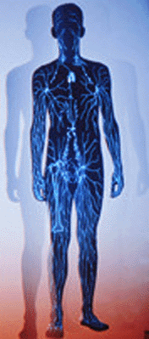




Вакцинација
Антиген (вакцина)
администрирана на
не-имуна особа
Активно
Имунизирана особа
Приемач
(Не-имуна особа)
Notes:
What about vaccination?
(→) In vaccination, the person to be protected is deliberately exposed to an antigen derived from a pathogen.
(→) The antigen, which has been treated so that it can’t produce disease symptoms, activates the immune system and stimulates a specific immune response with the production of sensitised lymphocytes, antibodies and memory cells. When the pathogen from which the antigen is derived is encountered later in the course of a natural infection, it will be rapidly and effectively neutralised before it can cause any damage.
Some antibodies and T-cells may be available to counter the infection immediately. There will also be a secondary response in which much greater numbers of sensitised lymphocytes and specific antibodies will be formed to attack the invading pathogen.

Slide 15
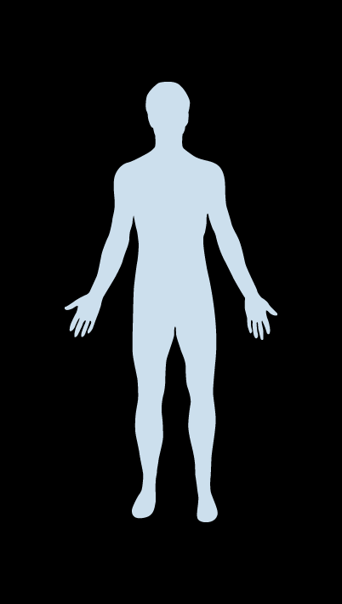
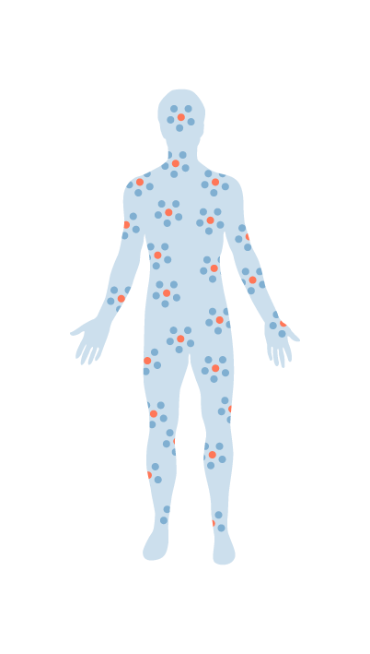
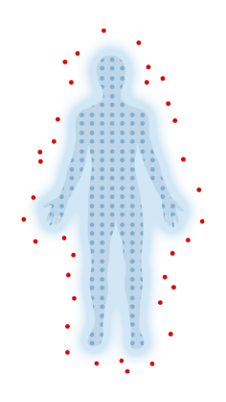
Што може да биде по природно од тоа да го користиме нашиот имун систем за да не заштити од болести
Вакцина
Администрација на ослабена или умртвена форма на предизвикувач на болест или дел од него.
Тоа го тренира имуниот систем да меморира и да се бори против вистинските агресори.
Нашиот имун систем има огромен капацитет да се бори против илјадници микроби.
Ако болеста некогаш нападне, нашиот имун систем ќе биде подготвен да ги уништи предизикувачите.
Notes:
Comments:
“ The principle upon which immunisation is based - namely, exposure to a non-harmful version of the naturally occurring infection in order to induce a natural and protective immune response - can be seen to be a far more natural process than the drug- and surgery-based therapies most widely venerated as the main achievements of modern medicine.” Adam Finn, Professor of paediatrics, University of Bristol (Viewpoint on BBC News, 13 March 2009 - http://news.bbc.co.uk/go/pr/fr/-/1/hi/health/7947863.stm)
How vaccines work: Harnessing the power of the immune system
In Brief: By using killed or modified micro-organisms (or parts or substances from these microbes) vaccines spark a natural immune response.
This process generates infection-fighting antibodies which provide immunity. A vaccine course (one or several doses) builds immunologic memory providing long-lasting protection. The immune system has unlimited capacity to respond.
Longer explanation:
“When a person is exposed to a disease-causing germ, the immune system attempts to mount a defense against it. When the defense is successful, immunity results. When the defense is not successful, an encounter with the bacteria or virus can result in disease and its consequences. In the process of developing immunity, the body produces substances known as antibodies against a specific germ and creates a “memory” of this experience that can be called upon for protection, when needed, many months or years later. The next time the person encounters that germ, the antibodies that circulate in the bloodstream prevent it from causing disease, or decrease the disease’s severity, and eliminate the germ from the body.
This is why a child who has had measles, for example, is unlikely to develop the disease again. The immune system has memory. The next time the child encounters the measles virus, the antibodies created during the previous infection are ready to neutralize and destroy the virus before it has a chance to cause sickness again.
A vaccine works in a similar way. However, instead of suffering the natural infection and risking its consequences in order to develop this protective immunity, a vaccine creates a similar immune protection without the recipient experiencing the disease. Regardless of the way that a vaccine is made—whether it contains an inactivated (killed) germ, a greatly weakened form of the germ, or a purified component of the virus or bacteria—it engages the immune system to create immunity to prepare to fight off an infection whenever it is encountered.” Source: The US National Network for Immunization Information (www.immunizationinfo.org) - 2002
What about giving multiple vaccines - does it overload the immune system?
The immune system has an enormous capacity to fight the thousands of bacteria, viruses and other pathogens that it is bombarded with every day. A study from America shows quite clearly that even babies who are poorly can still produce protective immune responses to vaccines. This study also shows that a baby could, in theory, respond to around 10,000 vaccines at any one time. If, for example, 11 vaccines were given to a baby at one time, this might only use about a thousandth of the immune system. In providing protection vaccines prevent ‘weakening’ of the immune system.
Source: NHS http://www.mmrthefacts.nhs.uk/resources/pdf/sheet2.pdf
See also Offit PA, et al. Addressing parents’ concerns: Do vaccines weaken or overwhelm the infant’s immune system? Pediatrics 109:124-129, 2002.
http://www.immunizationinfo.org/immunization_issues_detail.cfv?id=140

Slide 16





Вакцините не штитат од микробите што предизвикуваат болести
Вируси
Бактерии
Токсини
Паразити
Germs
Notes:
16
Comments:
When a person is exposed to a disease-causing germ, the immune system attempts to mount a defense against it. When the defense is successful, immunity results. When the defense is not successful, an encounter with the bacteria or virus can result in disease and its consequences. In the process of developing immunity, the body produces substances known as antibodies against a specific germ and creates a “memory” of this experience that can be called upon for protection, when needed, many months or years later. The next time the person encounters that germ, the antibodies that circulate in the bloodstream prevent it from causing disease, or decrease the disease’s severity, and eliminate the germ from the body.
This is why a child who has had measles, for example, is unlikely to develop the disease again. The immune system has memory. The next time the child encounters the measles virus, the antibodies created during the previous infection are ready to neutralize and destroy the virus before it has a
chance to cause sickness again.
A vaccine works in a similar way. However, instead of suffering the natural infection and risking its consequences in order to develop this protective immunity, a vaccine creates a similar immune protection without the recipient experiencing the disease. Regardless of the way that a vaccine is made—whether it contains an inactivated (killed) germ, a greatly weakened form of the germ, or a purified component of the virus or bacteria—it engages the immune system to create immunity to prepare to fight off an infection whenever it is encountered.
Source: The US National Network for Immunization Information (www.immunizationinfo.org) - 2002

Slide 17

Вакцините можат да им помогнат на луѓето ако сите партнерски работиме
Здравствени авторитети
Дефинираат најдобра примена и обезбедуваат пристап и имплементација
Помагаат и промовираат програми за вакцинација
Регулаторни авторитети/тела
Оценуваат и мониторираат ефикасност, безбедност и квалитет
Индустрија
Развива и произведува ефективни и безбедни вакцини
Придонесува за имплементација и мониторирање
Медиуми
Одговорно известување засновано за познавање и факти
Луѓе
Академија
Обезбедува базични истражувања и нови концепти и технологии
Здравствени работници
Советуваат за бенефитите и ги имплементираат програмите
Notes:
Note: The aim of this slide is to define the responsibility of the various partners, not the responsibility of the public.
Adapt call to action according to local context

Slide 18
Несакан ефект регистриран после вакцинација може на биде или не од вакцината
Коинциденција
Природно појавување на настани не предизвикани од вакцината…
…но регистрирани по вакцинацијата
Несакан ефект
Сите настани регистрирани во времена поврзаност со вакцинацијата
Несакан ефект
Предизвикан од администрацијата на вакцината или од самата вакцина
Грешка во припрема, ракување или администрација
Реакција од инјекцијата
Реакција од вакцината
(1) WHO website http://www.who.int/immunization_safety/aefi/en/ - see document on investigation of adverse events following immunisation http://www.who.int/vaccines-documents/DocsPDF05/792.pdf – last accessed August 2009; (2) UK Department of Health. Green Book « Immunisation against Infectious Disease »– Chapter 8, August 2007- http://www.dh.gov.uk/en/Publichealth/Healthprotection/Immunisation/Greenbook/index.htm - accessed 26 June 2009
Notes:
Comments:
What is an adverse event following immunisation ?
A medical incident that occurs after immunisation and causes concerns. It is believed to be caused by the vaccine … but is not necessarily.
4 types of adverse events following immunisation
“Vaccine” reaction (local, systemic) caused by the vaccine’s inherent properties
“Injection” reaction: caused by the injection and not the vaccine – anxiety, fainting, pain at the injection site …
Co-incidental event: temporally associated with vaccination but not caused by it (like life accidents)
Programme-related: resulted from inappropriate practices in the provision of vaccination, including but not limited to administering the wrong dose of vaccine, using vaccines beyond expiry date, using vaccines at inappropriate intervals.
But adverse reactions should be distinguished from adverse events
Adverse reactions are undesirable outcomes which are caused by the vaccine with evidence supporting a causal link.
Adverse events are undesirable outcomes which occur after immunization. It is believed to be caused by immunization but it is not necessarily caused by vaccination.
Sources: WHO (P.Duclos), May 2008 and Halsey, Institute for Vaccine Safety, J Hopkins University

Slide 19
Кога голема популација е вакцинирана, природното појавување на болести е веројатно дека ќе коинцидира со вакцинацијата
Дијагностицирани случаи по инјекција на placebo кај 1 милион адолесценти и млади девојки/ период на обсервација
Коинциденција во појавување на дијабетес ако 1 милион млади девојки се вакцинираат со placebo
Болест
1 Ден
1 Недела
6 Недела
Астма
27
188
813
4
случаи
29 случаи
128 случаи
Алергија
15
106
458
Воспалителна болест на цревата
2
10
45
1 ден
1 недела
1 недела
6 недела
Дијабетес
4
29
128
Тироидитис
1
9
40
Системски Лупус
1
5
20
Вакцинација
Мултипла Склероза/
Оптички Невритис
0
2
10
(1) Adapted from Siegrist CA, Lewis E et al., Pediatric Infectious Disease Journal, 26[11], 979-984. 2007
Notes:
Study details: See also in back up results of a similar study conducted in Denmark
Siegrist and colleagues performed modelling studies to assess the effects of large-scale immunisation with the HPV vaccine.¹
The model was based on calculating the rates of emergency consultations, hospitalisations, outpatient consultations and risks of coincident associations in a female cohort of adolescents (n=214,896) and young adults (n=221,472) in the pre-HPV vaccination era (2005).¹
Various assumptions needed to be made for the purpose of creating a model including¹:
The medical events that occurred during the year were considered to be random
Each visit to the emergency room and hospitalisations had a medical purpose
The establishment of different time windows for follow-up (e.g. daily, weekly and 6-weekly)
The vaccine would be administered on a 0, 1, and 6-month schedule
There were no vaccine induced adverse events.
The results revealed that immune-mediated conditions accounted for 10.3% of emergency room consultations by adolescent girls.¹ Non-allergic immune-mediated conditions affected 86 per 100,000 population, with diabetes ranking first.¹
The table presented on the slide reveals the estimated rate of emergency room visits and hospitalisations that are likely occur for the particular disease types within 24 hours, one week and six weeks of HPV vaccine administration.
References:
Siegrist CA, Lewis EM, Eskola J et al. Human papilloma virus immunization in adolescents and young adults: A cohort study to demonstrate what event might be mistaken for adverse reactions. Pediatr Infect Dis J 2007;26:979–984.

Slide 20
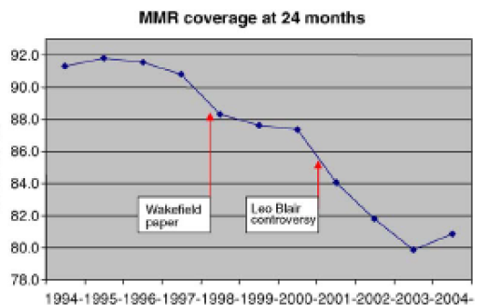
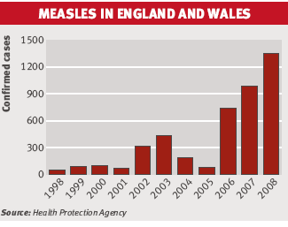
Во УК, вакцината за заушки, морбили и рубела беше обвинета дека предизвикува аутизам
Една студија сугерираше, во 1998, дека МРП вакцината предизвикува болест на цревата што води до аутизам.^{(1-3,5)}
Производителите и авторитетите побараа од експертите да изведат студии, за да ја испитаат потенцијалната поврзаност.
25 студии не најдоа никаква поврзаност ^{(1,3-4)}
  Во различни земји, од различни инвестигатори и со различни епидемиолошки и статистички методи
  Доволно големи за да детектираат и ретка поврзаност (една студија во Канада вклучуваше 28,000 деца; Финските испитувачи прегледаа медицински записи на 1,8 милиони деца)
Иницијалната студија се докажа дека е погрешна^{(1-3,5)}
  10 од 13 автори бараа повлекување и изјавија дека студијата не докажува причинска поврзаност ⁽⁵⁾
WHO и националните здравствени авторитети препорачуваат континуирана вакцинација ⁽⁵⁻⁷⁾
Неоснованиот страв предизвикал многу контроверзи, што резултирало со колапс на вакцинацијата со МРП вакцината, што довело до нагло појавување на случаи на морбили ^{(8,9).}
(1) Gerber J., Offit P., Vaccines, CID 2009:48, 15 Feb 09; (2) Wakefield A. et al., The Lancet 1998, 351:637-41; (3) P Offit, Autism’s False Prophets, Columbia University Press, 2008, P.41-45; (4) Immunization Action Coalition fact sheet, Nov 08 www.immunize.org/catg.d/p4026.pdf; (5) Murch SH, Anthony A, Casson DH, et al . 2004, "Retraction of an interpretation". Lancet 363; 9411:750; (6) WHO 2001 http://www.who.int/vaccines-diseases/safety/hottop/mmrstatement.shtml – accessed June 26 2009; (7) Vaccination schedules within the EU– EU Commission 2007: VENICE project http://venice.cineca.org/Report_II_WP3.pdf – accessed June 26 2009 (8) UK Department of Health, Medical Research Council 1998 and 2000, ref. MRC/18/00 -www.immunisation.nhs.uk/files/factsheets1-3.pdf ; (8) Burgess DC et al., Vaccine, 24, 18:3921-8 ; (9) BMJ, vol. 338, 14 Feb. 2009.
Notes:
Comments and additional data:
It has been claimed that MMR vaccine causes acute gastrointestinal symptoms and that there should therefore have been long-term surveillance of potential long term gastrointestinal sequelae. This is but the latest in a series of unsubstantiated claims about the alleged adverse effects of the MMR vaccine, the most recent of which is that MMR vaccine causes autism.
Hypotheses have changed overtime. Measles virus (either wild or vaccine-type on its own or in the presence of mumps and/or rubella viruses) were accused of causing either Crohn’s disease and/or ulcerative colitis, or autism associated with an inflammatory bowel condition that is neither Crohn’s disease nor ulcerative colitis. All of these claims have been associated with the work of one researcher, A.J. Wakefield.
The evidence relating to these putative long-term effects of MMR vaccine has been reviewed on repeated occasions by expert groups in the UK and the USA and in editorials and review articles published in peer-reviewed journals. The conclusions of these disparate groups have been unequivocal; there is no credible scientific evidence in support of a causal link between MMR vaccine and either inflammatory bowel disease or autism.
Based on extensive review, WHO concluded in 2003 that no evidence exists of a causal association between MMR vaccine and autism or autistic disorders. WHO recommends continued vaccination.
Position of authorities: - See unchanged vaccination schedules within the EU 2007– EU Commission: VENICE project:http://venice.cineca.org/Report_II_WP3.pdf
UK: In April 2000 the Medical Research Council stated that ‘there is no new evidence to suggest a causal link between MMR vaccination and autism or inflammatory bowel disorders’. Medical Research Council press release, 3 April 2000. ‘No new evidence of a link between MMR and autism’, ref. MRC/18/00.
WHO: In January 2001, the World Health Organisation (WHO) released its latest view of the evidence on the safety of MMR vaccine. Their statement reads: ‘WHO strongly endorses the use of MMR (measles, mumps and rubella) vaccine on the grounds of its convincing record of safety and efficacy. The combination vaccine is recommended rather than the monovalent presentation when available and the disease burden justifies its use. There has been no new scientific evidence that would suggest impaired safety of MMR. On the contrary, all results from vaccine trials published reaffirm the high safety and efficacy of MMR vaccine.’
World Health Organisation statement on the use of MMR vaccine, 24 January 2001, http://www.who.int/vaccines-diseases/safety/hottop/mmrstatement.shtml.
References:
P Offit, “Vaccines and autism. A tale of shifting hypotheses” Vaccines, CID 2009:48, 15 Feb 09
WHO - http://www.who.int/vaccine_safety/topics/mmr/mmr_autism/en/ - last accessed 2 April 2009
NHS MMR fact sheet http://www.immunisation.nhs.uk/publications/factsheets1-3.pdf
Immunization Action Coalition fact sheet “MMR vaccine does not cause autism Examine the evidence! » Nov 08 www.immunize.org/catg.d/p4026.pdf • Item #P4026 (11/08) http://www.immunizationinfo.org/iom_reports_detail.cfv?id=15

Slide 21

Неоправдан страв или разумен скептицизам?
Што ги прави вакцините безбедни
Екстензивни тестирања во клиничките студии
Опсежни евалуации од регулаторните авторитети
Строга контрола и мониторирање на несаканите ефекти
Соодветно чување, ракување и администрирање
Внатрешна контрола на квалитет во процесот на
производство и пуштање на серија во промет
(1) WHO – P. Duclos- presentation to Advanced Course of Vaccinology (ADVAC), May 2008, p.8

Slide 22
Безбедноста е испитувана во робусни клинички студии, пред одобрување од авторитетите ^{(2,3)}
Екстензивни тестирања во клиничките студии
Неколку години на строги тестирања на илјадници испитаници ⁽¹⁾
Фаза 3
(2 до 4 години)
Фаза 2
(1 до 2 години)
Безбедност и подносливост
Фаза 1
(1 до 2 години)
Безбедност
Неколку илјади испитаници
Безбедност
Неколку стотици испитаници
Ограничен број на испитаници
Во согласност со строгите регулаторни критериуми и одобрено од авторитетите и етичките комисии ⁽²⁾
Сите забележани несакани ефекти се пријавени, без разлика дали се предизвикани или не од вакцинацијата, и анализирани од независни експерти ^{(2,4)}
(1) NHS http://www.immunisation.nhs.uk/About_Immunisation/Safety/Clinical_trials – accessed on 26 June 2009 ; (2) EU rules and guidance applying to clinical trials http://ec.europa.eu/enterprise/pharmaceuticals/eudralex/vol10_en.htm#chap5 – accessed July 2009 – in particular 2001/20/EC Directive http://ec.europa.eu/enterprise/pharmaceuticals/eudralex/vol-1/dir_2001_20/dir_2001_20_en.pdf (3) UK Department of Health. Greenbook Chap. 9, 2006 http://www.dh.gov.uk/PolicyAndGuidance/HealthAndSocialCareTopics/Greenbook/fs/en - accessed 26 June 2009 (4) EU detailed guidance on collection, verification and presentation of adverse events reports arising from clinical trials, 2006 - http://ec.europa.eu/enterprise/pharmaceuticals/eudralex/vol-10/21_susar_rev2_2006_04_11.pdf –
accessed July 2009
Notes:
Comments:
Different phases of a vaccine clinical study
Phase 1 - Safety
These initial trials are done on a small number of healthy adult volunteers (about 10-50 people).
This phase tests the safety of doses and the volunteers are monitored for short-term side effects.
− Gross safety assessment
− First information on immune response (immunogenicity: ability of the vaccine to induce specific antibodies )
Phase 2 - Safety and immune response
With the information from Phase 1, the vaccine is then tested on several hundred people from the age group for which the vaccine is intended, e.g. elderly people, babies or older children. 100 to 300 subjects
The vaccine is tested for safety and also to see that it does produce the immune response needed to prevent the disease.
This phase is often carried out in several different centres in order to provide information for the Phase 3 studies and for the regulatory bodies.
− Doses, schedules, administration routes
− Immune response (Immunogenicity)
− Safety
Phase 3 - Safety, immune response and efficacy
This phase uses thousands of volunteers of the relevant age group. Its purpose is to show that the vaccine works safely in preventing the disease for which it is intended and has minimal side effects. - 1000 to 100,000 subjects
This is the first step towards its use in public health.
International trials are also necessary, especially if the vaccine is designed to be used in a country outside the one where it has been made.
All the information collected is then examined to make sure that the vaccine passes the safety and efficacy requirements.
− Clinical efficacy
− Safety, immunogenicity
− Comparison with other products
Source: adapted from NHS http://www.immunisation.nhs.uk/About_Immunisation/Safety/Clinical_trials

Slide 23
За да се добие одобрување, безбедноста е внимателно евелуирана, од регулаторните авторитети
Евалуации од регулаторните авторитети
Пример на централизирана постапка на одобрување на вакцина
Европска Медицинска Агенција*
Комитет од 35 експерти
(вкл. 1/ЕУ земја членка
+ Исланд и Норвешка)
Помогнат од специјализирани групи
Апликација за одобрување
Резултати од клинички студии
Quality
Expert
Group
Efficacy
Expert
Group
Консензуално мислење
ЕУ одобрување
Vaccine
Expert
Group
Paediatric
Committee
Safety
Expert
Group
Pharmaco-
vigilance
Expert
Group
Patients
and
consumers
Groups
13 до 15 месеци за евалуација во просек ⁽³⁾
* Centralised procedures used for the most recent and innovative vaccines. Other vaccines are covered by national authorities in comparable procedures (1) EMEA website http://www.emea.europa.eu/htms/general/contacts/CHMP/CHMP.html – accessed on June 26 2009 ; (2) EU Directive 2001/83/EC Community Code relating
to medicinal products for human use, art. 8 and 21.4 - http://ec.europa.eu/enterprise/pharmaceuticals/eudralex/vol-1/dir_2001_83_cons/dir2001_83_cons_20081230_en.pdf- accessed July 2009. (3) EMEA Annual Report, 2008, p.25 -http://www.emea.europa.eu/pdfs/general/direct/emeaar/AnnualReport2008.pdf– accessed on August 2009
Notes:
Comments (complement with local procedures):
Evaluation of license application can be conducted either at EU level (centralised procedure) or at national level (decentralised procedure). The criteria and processes of assessment are comparable [see procedures in France 1].
The European Medicines Agency (EMEA) is responsible for the scientific evaluation of applications for European marketing authorisation for medicinal products. Under the centralised procedure, companies submit a single marketing authorisation application to the EMEA. Once granted by the European Commission, a centralised marketing authorisation is valid in all European Union (EU) and EEA-EFTA states (Iceland, Liechtenstein and Norway). The Agency is also involved in referral procedures relating to medicinal products that are approved or under consideration by Member States in non-centralised authorisation procedures.
Scientific committees, composed of members of all EU and EEA-EFTA states, some including patients’ and doctors’ representatives, conduct the main scientific work of the Agency. The committee reviewing vaccines (Committee for Medicinal Products for Human Use) relies on the expertise of 7 expert groups.
The Agency brings together the scientific resources of over 40 national competent authorities in 30 EU and EEA-EFTA countries in a network of over 4,500 European experts. It contributes to the European Union’s international activities through its work with the European Pharmacopoeia, the World Health Organization.
Source: EMEA website
http://www.emea.europa.eu/htms/general/contacts/CHMP/CHMP.html
[1] Decentralised procedure in France: http://www.afssaps.fr/Activites/Autorisations-de-mise-sur-le-marche/Definition-et-modalite-des-AMM/%28offset%29/0

Slide 24


Строга контрола на квалитет во процесот на производство и пуштање на серија во промет
Контрола на квалитет во производствен процес
Дистрибуција
Vaccines are produced
in batches
Batch release
70% од времето на производство се троши на контрола на квалитетот ⁽²⁾
1 на 4 вработени во производство се бави со контрола на квалитет ⁽³⁾
Пред пуштање на серија во промет авторитетите ја тестираат секоја серија ⁽¹⁾
Each batch is subject to more than 50 quality controls ⁽³⁾
Packaging
Filling
Formulation
Inactivation
Purifications
Harvests
(1) EU Directive 2003/94/EC laying down the principles and guidelines of good manufacturing practice in
respect of medicinal products for human use http://ec.europa.eu/enterprise/pharmaceuticals/eudralex/vol-1/dir_2003_94/dir_2003_94_en.pdf Accessed July 2009 (2) Sanofi Pasteur Internal data - http://www.sanofipasteur.com/sanofi-pasteur2/front/index.jsp?siteCode=SP_CORP&codeRubrique=31(3) Sanofi Pasteur internal data
Cultures
of seeds
Notes:
Comments:
The safety and efficacy profile of each batch of vaccines is assured by the control of product quality. Product quality cannot be assured by finished product testing alone. It also depends on control of process, equipment, facilities, personnel and materials which are all subjects to norms and inspections by regulatory authorities.
Vaccines contain active biological ingredients which require high quality standards. From the selection of microbial seeds to distribution, all steps are controlled according specific international norms and guidelines. Infectious germs are cultivated, harvested and purified. The formulation combines the types of antigens in a stable and homogeneous lot which is then filled in containers (vials, syringes) and packaged (incl. label, leaflet). Until now a batch has undergone more than 50 control tests along the manufacturing process. To be released on the market and distributed, each batch has to be controlled again by national regulatory authorities with different tests and the checking of manufacturing data.
Purification consists in separating the relevant antigen(s) from the crude extract obtained after culture harvest and concentration.
Inactivation consists in destroying the harmful properties of the antigen(s), while retaining their immunogenic power.
Formulation consists in combining the different types of antigens and manufacturing a stable homogenous lot, further tested in quality control for all its properties.
Filling consists in washing, sterilzing and filling the final containers (eg vials, syringes).
Example of control and inspection by authorities: The manufacturer has to
- Demonstrate manufacturing process consistency of large-scale lots (validation processes, measurement of vaccine potency, etc.)
- Prove that procedures meet the requirements or regulations
- Prove that the manufacturing and testing methods comply with your license requirements
Inspection of the manufacturing line/equipement
In case of non-compliance, sanctions from national regulatory authorities may range from warning letter to license suspension/revocation.

Slide 25
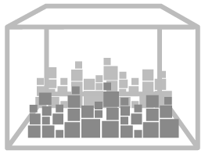





Строга контрола и безбедност во чување на вакцините, ракување и администрирање
Соодветно чување, ракување и администрирање
Внимателно контролирани услови (пр. ладен ланец на дистрибуција)
Контрола при чување, ракување и администрирање, за да се превенираат грешки
Пример на такви грешки:
  - Грешна инјекција (грешна локација)
  - Контаминација на повеќе=дозни вијали
  - Замена на вакцината со дилуентот
Континуирана контрола на ладниот ланец од производната локација до ординацијата на докторот
(1) WHO website: http://www.who.int/vaccines-documents/DoxGen/H5-CC.htm - accessed June 26 2009
(2) N. Halsey, Institute for Vaccine Safety, J Hopkins University - presentation to AVDVAC, May 2008
Notes:
Comments:
Like other biological products vaccines require carefully controlled conditions. From shipping to administration, controls check that the cold chain has not been interrupted.
At any time in the process of distribution and at the time a vaccine is administered the vaccine vial monitor (VVM) indicates whether the vaccine has been exposed to a combination of excessive temperature over time and whether it is likely to have been damaged. It clearly indicates to health workers whether a vaccine can be used.
Quality assurance strandards by WHO and national authorities are in place to ensure proper storage, handling and administration (incl. disposal). Authorities define best practices. Guidance includes standards and good practices regarding shipping requirements; condition upon arrival; storage requirements; shelf life; instructions for reconstitution and use; shelf life after reconstititution, thawing and opening; and any special instructions for all recommended vaccines.
Compliance with standards is essential to prevent incidents and ensure optimal vaccination safety.
Example of guidance: CDC http://www.cdc.gov/Ncidod/Dq/pdf/ti_vacc_handl_admin_guid.pdf
Sources:
WHO (P.Duclos), May 2008
WHO website: http://www.who.int/vaccines-documents/DoxGen/H5-CC.htm
http://www.who.int/vaccines-documents/DocsPDF99/www9928.pdf
CDC, http://www.cdc.gov/vaccines/pubs/vac-mgt-book.htm [last accessed April 2009]
Halsey, Institute for Vaccine Safety, J Hopkins University

Slide 26
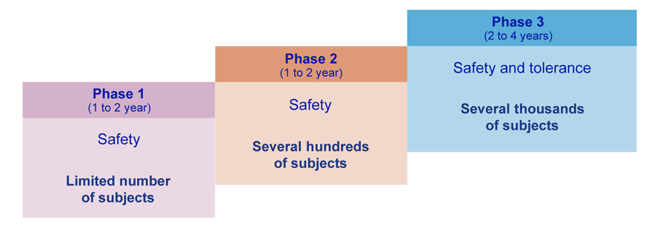
Контролата и мониторирањето на безбедноста продолжува по одобрувањето
Контрола и мониторирање на несаканите ефекти
Одобрување
Контрола
Контрола на клиничките студии Дополнителни студии за безбедност
План за управување со ризиците
Мониторирање на спонтани пријави
(1) Adapted from NHS http://www.immunisation.nhs.uk/About_Immunisation/Safety/Clinical_trials – accessed June 26 2009
(2) UK Department of Health. Greenbook Chapter 9, 2006. http://www.dh.gov.uk/PolicyAndGuidance/HealthAndSocialCareTopics/Greenbook/fs/en Accessed October 2006
Notes:
Note: adapt with other examples
Comments:
Vaccines are under constant surveillance throughout their life cycle. Before and after licensure vaccine safety is continuously evaluated to detect any signal of a potential adverse event.
Several thousands of subjects from the last phase of clinical studies are followed for 4 to 10 years after the study's completion.
Large active post-marketing surveillance programme are also in place to carefully monitor the benefit/risk ratio in practical use. They can include up to 44,000 subjects (eg HPV vaccination).
In addition, complementary studies further examine vaccine safety in special populations (eg pregnant women) or in concomitance with the use of other vaccines.
All theses studies are carried out in close coordination with regulatory agencies, national health authorities and independent experts.
Sources:
UK Department of Health. Immunisation against Infectious Disease. Surveillance and monitoring for vaccine safety Chapter 8, August 2006. http://www.dh.gov.uk/PolicyAndGuidance/HealthAndSocialCareTopics/Greenbook/fs/en Accessed April 2009
French authorities- AFSSAPS http://www.afssaps.fr/Activites/Pharmacovigilance/Pharmacovigilance/%28offset%29/0 - Accessed April 2009

Slide 27



Вредноста на вакцините: ‘Најголема вредност во медицината’
Големи сипаници
Ерадицирани
Полио
Светската инциденца намалена за 99%
Tetanus, diphtheria,
rubella, meningitis
и рак на црн дроп
(последица од hepatitis B)
Драматична редукција
Haemophilius Influenza type b
Намалена инциденца
во Европа за преку 90%
Морбили
Под контрола (во САД и делови на Европа) Драматична редукција
(број на смртни случаи намален за 91% во Африка)
Индивидуална
3 милиони смртни случаи се превенирани
400 милиони животи годишно се спасени
750,000 деца се спасени од инвалидитет
Општествена
“Со исклучок на чистата вода за пиење, вакцините се нај ефективната интервенција за намалување и превенирање на инфективните болести”
Економска
Decreased permanent disabilities
Decreased loss
of productivity
Notes:
Possible sum-up slide to be used, if necessary, at local level.

Slide 28
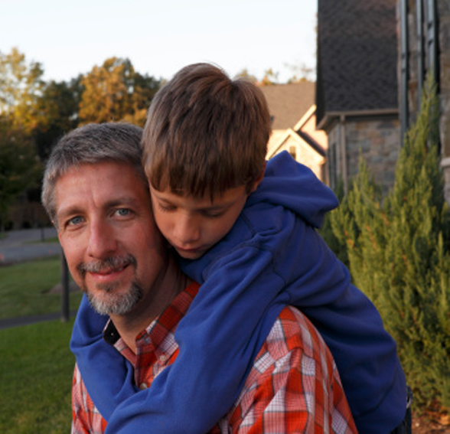


Спасуваат животи и го подобруваат здравјето
Вредноста на вакцините
Исплатлива и ефективна здравствена инвестиција
Заштитуваат поединци и општествената заедница
Notes:
To summarise, vaccines have a positive effect on individuals, communities and economies.
The following slides provide some specific examples of these benefits in real-world situations.

Slide 29
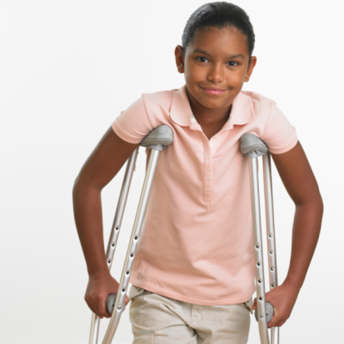
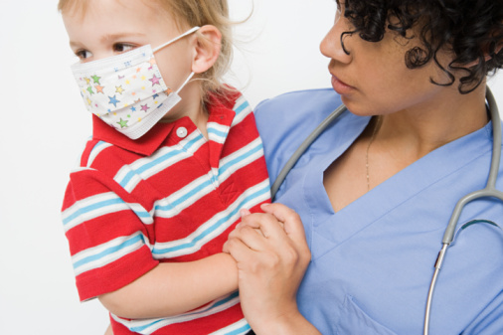
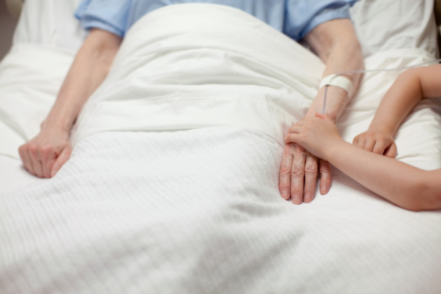
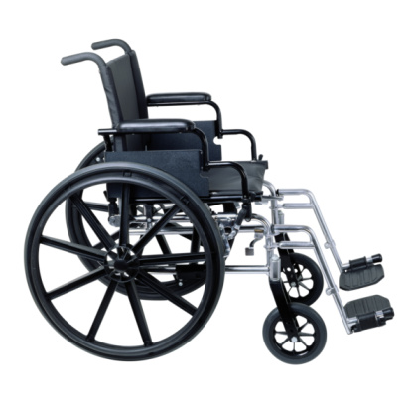

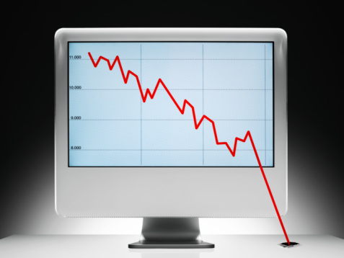
Вредноста на вакцините
Намалена хоспитализација
Намалени трајни инвалидитети
Намалена појава на болест
Лимитирани долготрајните последици од болестите
Намалена загубата на продуктивност
Намалени долгорочните трошоци за здравствена заштита
Notes:
Vaccination is a proven method for controlling and even eradicating disease; for example smallpox was eradicated in 1979 after a massive worldwide immunisation campaign.¹³
‘Herd immunity’ – the state in which immunisation levels are so high that even those not immunised may be protected – has also been observed in instances where levels of vaccination are very high.¹⁴
For example, studies have suggested that rotavirus vaccination may limit the transmission of the virus, thereby protecting older children who cannot be vaccinated.¹⁰
¹³ UNICEF. The progress of nations 1996 – Health. February 2006. Available at: http://www.unicef.org/pon96/hevaccin.htm (Last accessed 18 April 2011)
¹⁴ WHO. Vaccination greatly reduces disease, disability, death and inequity worldwide. Bulletin of the WHO 2008; 86(2): 81-160
¹⁰ Patel M et al. Real-world impact of rotavirus vaccination. The Paediatric Infectious Disease Journal 2011; 30(1): S1-S5
Vaccination campaigns can decrease hospitalisations – and with this reduce the significant costs associated with in-patient stays.
Since the introduction of the rotavirus vaccine in national immunisation programmes in 2006, dramatic reductions in severe cases of childhood diarrhoea resulting in hospitalisation have been observed in countries with a range of economic statuses.¹⁰
¹⁰ Patel et al. Real-world impact of rotavirus vaccination. The Pediatric Infections Disease Journal 2011; 30(1): S1-S5
Vaccines can reduce permanent disabilities caused as a result of vaccine-preventable diseases.
For example, since the launch of the Global Poliomyelitis Eradication Initiative (GPEI) in 1988 more than 5 million cases of paralytic polio have been prevented.⁴ Previously these would have resulted in patients, mainly children, being confined to a life using crutches, braces, wheelchairs and iron lungs.
⁴ WHO Fact sheet No 114 November 2010 Available at http://www.who.int/mediacentre/factsheets/fs114/en/index.html (Last accessed 28 February 2011)
Diseases can have a significant impact of productivity – with adults in employment either missing time from work due to their own illness, or the need to care for a dependent such as a child or elderly relative.
In the USA the economic burden of influenza is estimated at $87.1 billion per year, when including indirect costs such as lost productivity, lost earnings and loss of life. Direct medical costs account for just $10.4 billion of this total.¹⁵
¹⁵ Monto A et al. Influenza control in the 21st century: Optimizing protection of older adults. Vaccine 2009; 27: 5043-5053
Vaccines have been proven to decrease long-term healthcare costs.
For example, a Kenyan study estimated that a one week ‘supplemental immunization activity’ against measles carried out in 2002 – in which approximately 13 million children were vaccinated – would result in a net saving of $12 million in healthcare costs over the following ten years.¹⁶
¹⁶ WHO. Fact sheet - Immunization against diseases of public health importance. March 2005. Available at: http://whqlibdoc.who.int/fact_sheet/2005/FS_288.pdf (Last accessed 9 May 2011)

Slide 30

За доброто на нашите најмили

